Slide 1
Puzzlebot Gazebo Simulator
Instructions manual

Slide 2
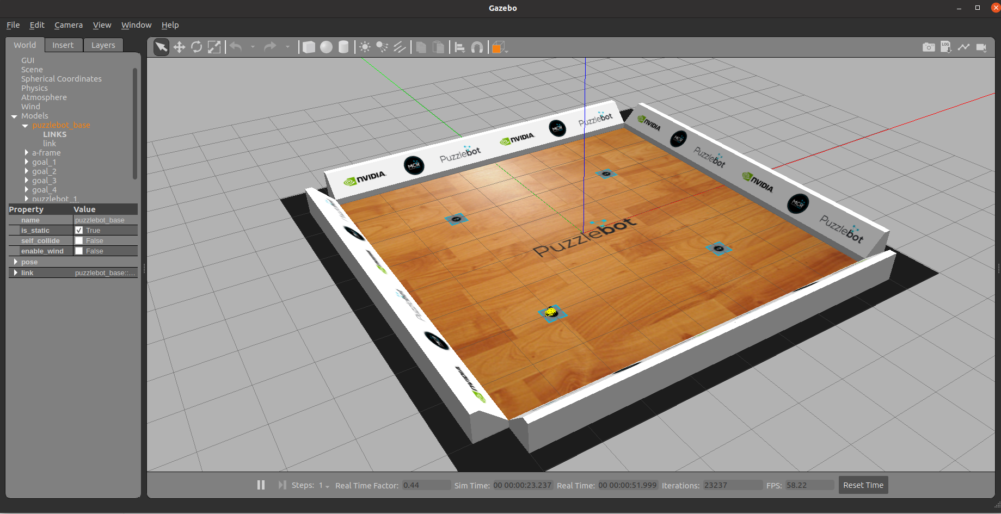
Gazebo simulation
Initialising the simulation
Download the ROS packages to your workspace source folder (e.g., catkin_ws/src)
Build and source the packages
Run the Puzzlebot gazebo simulator using the following command
The following screen should appear
puzzlebot_gazebo
puzzlebot_control
puzzlebot_description
$ roslaunch puzzlebot_gazebo puzzlebot_gazebo.launch
$ cd ~/catkin_ws/
$ catkin_make
$ source devel/setup.bash

Slide 3
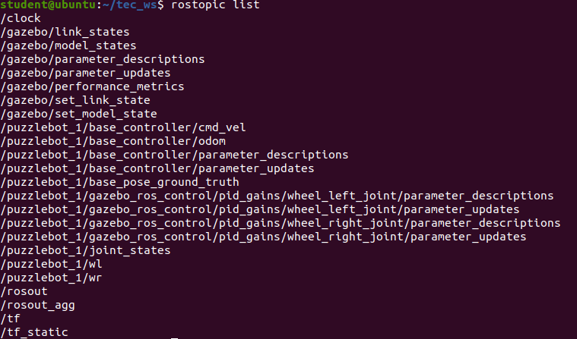
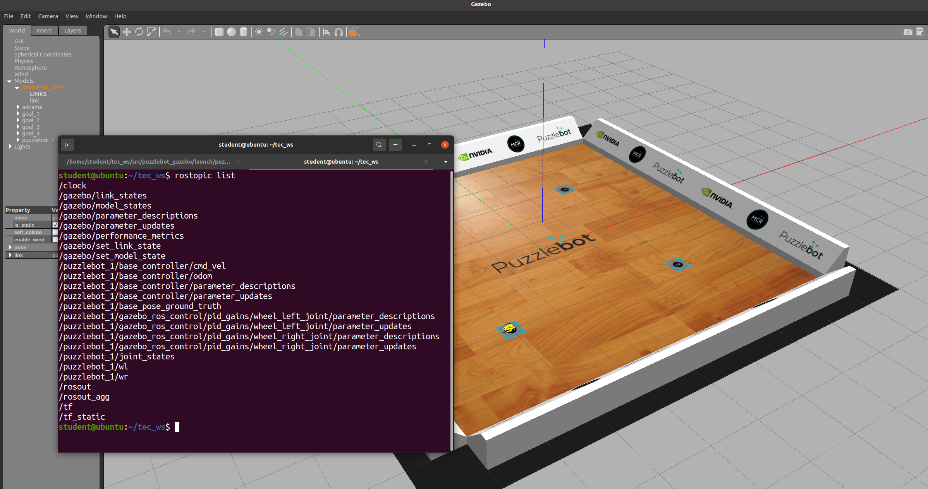
Gazebo simulation
Initialising the simulation
Open another terminal
Verify the topics generated by the simulator using the following command
The following list of topics should appear
$ rostopic list

Slide 4
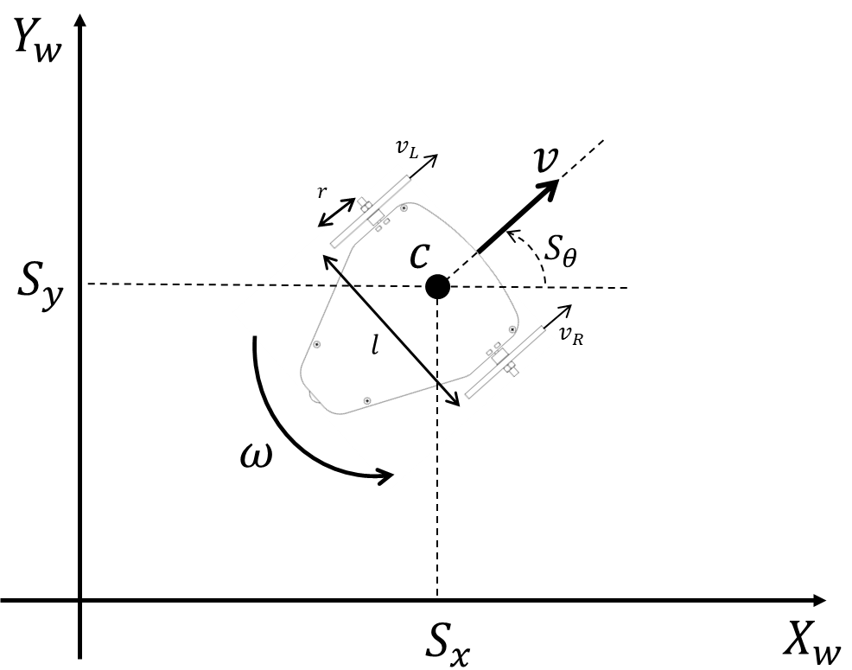
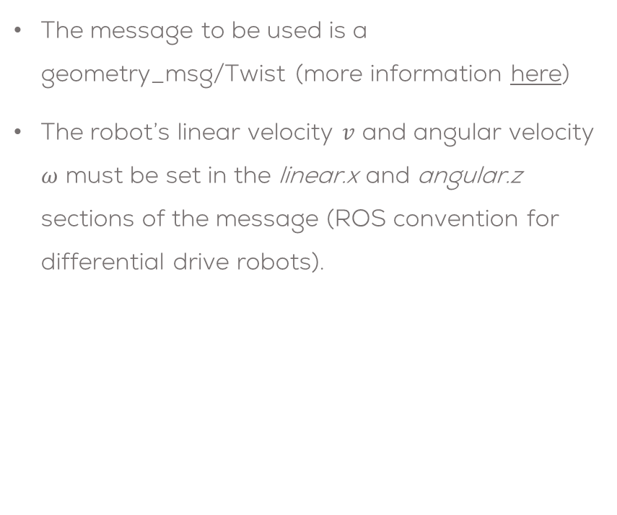
Gazebo simulation
Running the simulation
Sending velocity commands to the robot is done using the following topic
The message to be used is a geometry_msg/Twist (more information here)
The robot’s linear velocity $v$ and angular velocity $ω$ must be set in the linear.x and angular.z sections of the message (ROS convention for differential drive robots).
/puzzlebot_1/base_controller/cmd_vel
Topic: /puzzlebot_1/base_controller/cmd_vel
Message: geometry_msgs/Twist
"linear:
x: linear_velocity (v)
y: 0.0
z: 0.0
angular:
x: 0.0
y: 0.0
z: angular_velocity (omega)"

Slide 5

Gazebo simulation
Running the simulation
To publish a message to the gazebo-simulated robot from the terminal can be done as follows.
The previous command will make the robot to run in a circle.
$ rostopic pub -r 10 /puzzlebot_1/base_controller/cmd_vel geometry_msgs/Twist "linear:
x: 0.3
y: 0.0
z: 0.0
angular:
x: 0.0
y: 0.0
z: 0.3"

Slide 6
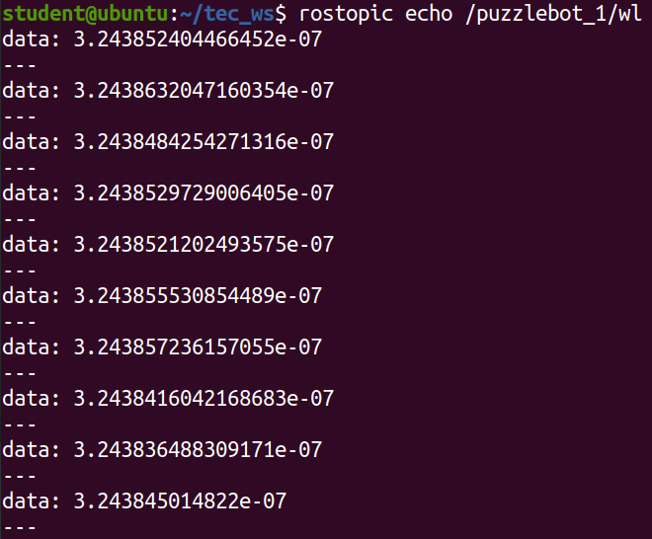
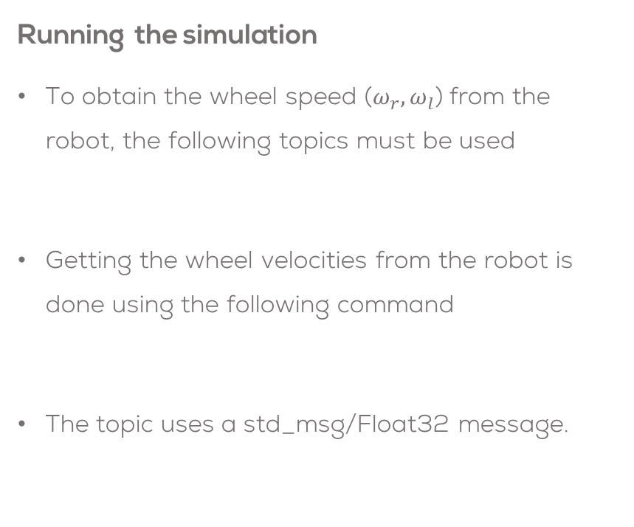
Gazebo simulation
Running the simulation
To obtain the wheel speed ($ω_{r}, ω_{l}$) from the robot, the following topics must be used
Getting the wheel velocities from the robot is done using the following command
The topic uses a std_msg/Float32 message.
/puzzlebot_1/wr
/puzzlebot_1/wl
$ rostopic echo /puzzlebot_1/wl
Topic: /puzzlebot_1/wl
Message: std_msgs/Float32

Slide 7
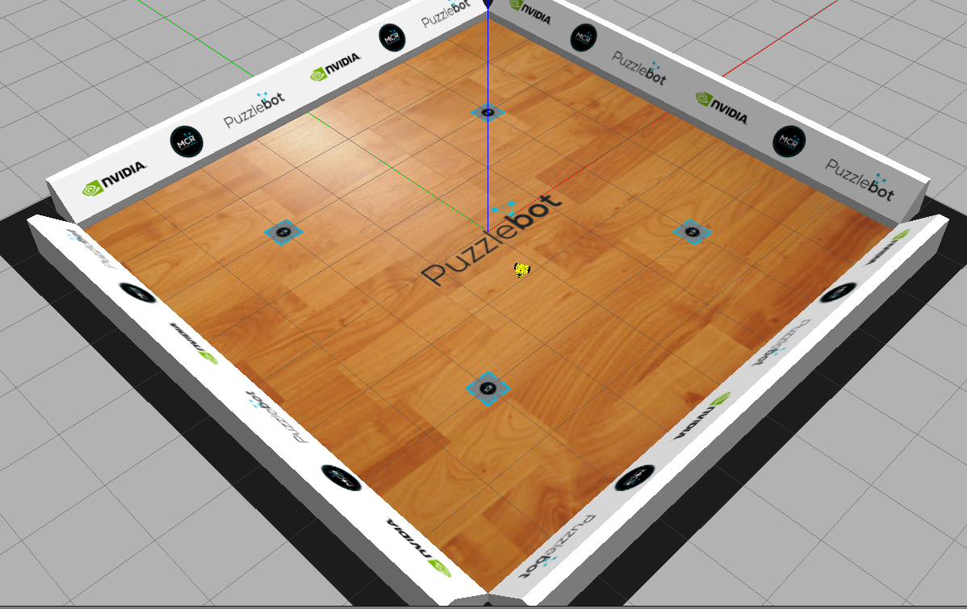
Robot Teleoperation
Install the teleoperation package
Run the gazebo simulator as described before
In another terminal, run the teleoperation node as follows
Control the robot using the keyboard (i, j, l, k) as described on the terminal.
sudo apt install ros-noetic-teleop-twist-keyboard
$ roslaunch puzzlebot_gazebo puzzlebot_gazebo.launch
rosrun teleop_twist_keyboard teleop_twist_keyboard.py _repeat_rate:=10 cmd_vel:=puzzlebot/cmd_vel _speed:=0.4 _turn:=1.1

Slide 8
Puzzlebot Gazebo Simulator
Advanced Features

Slide 9
Changing Puzzlebot model
Puzzlebot Models
Open the file “puzzlebot_gazebo.launch” in the “puzzlebot_gazebo” package
Line 7 controls the type of Puzzlebot to be simulated.
Change “default :=“ value line 7 with one of the following descriptions according to your needs
Puzzlebot Hacker Edition
Puzzlebot Jetson Edition
Puzzlebot Jetson-Lidar Edition
Puzzlebot Models
The simulator contains the three versions of the Puzzlebot
Each version simulates the sensors contained in the Puzzlebot such as the camera, lidar and encoders.
~/puzzlebot_gazebo/launch/puzzlebot_gazebo.launch
Puzzlebot Hacker Edition
Puzzlebot Jetson Edition
Puzzlebot Jetson-Lidar Edition
<arg name="robot_description_file" default="puzzlebot_hacker_ed_v1_3.xacro"/>
default="puzzlebot_hacker_ed_v1_3.xacro"
default="puzzlebot_jetson_ed_v1.xacro"
default="puzzlebot_jetson_lidar_ed_v1.xacro"

Slide 10
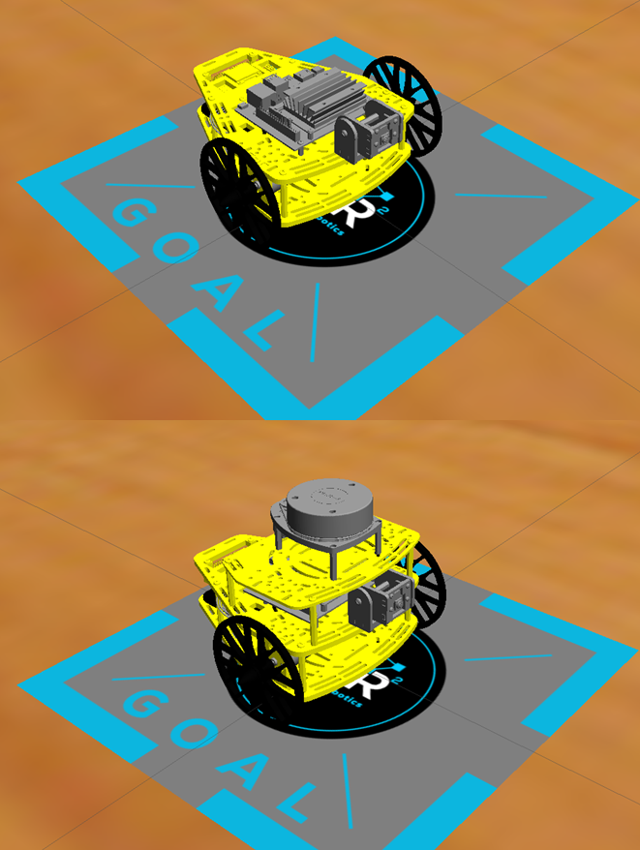
Changing Puzzlebot model
Save the file
Follow the instructions in the previous section to initialise the Gazebo simulator.
The following models should appear on the screen.

Slide 11
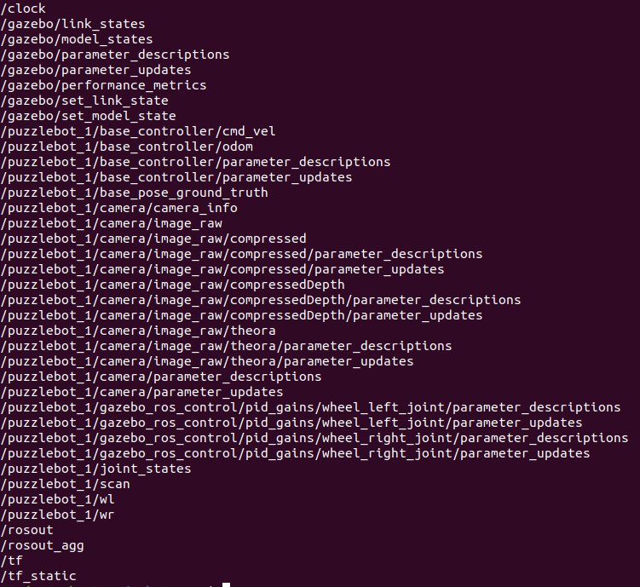
Changing Puzzlebot model
Each robot contains differet topics according to the sensors and the information published.
Use a “rostopic list” command to view the topics of each robot

Slide 12

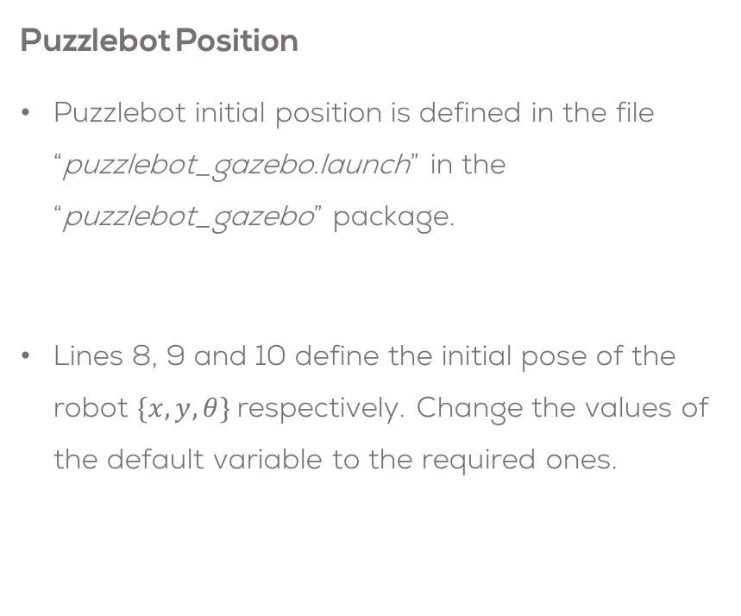
Changing the position of the robot
Puzzlebot Position
Puzzlebot initial position is defined in the file “puzzlebot_gazebo.launch” in the “puzzlebot_gazebo” package.
Lines 8, 9 and 10 define the initial pose of the robot $\{x,y,θ\}$respectively. Change the values of the default variable to the required ones.
~/puzzlebot_gazebo/launch/puzzlebot_gazebo.launch
<arg name="pos_x" default="-2.0"/>
<arg name="pos_y" default="-2.0"/>
<arg name="pos_theta" default="0.0"/>

Slide 13
Changing the environment
Puzzlebot Environments
MCR2 provide different environments for the Puzzlebot to interact with.
The available environments are in the package “puzzlebot_gazebo” in the folder “worlds”.
The world description files are the ones ending in “.world”.
Changing the environment
Open the file “puzzlebot_gazebo.launch” in the “puzzlebot_gazebo” package.
Line 13 controls the environment to be used.
Change the value of the name in the default value by the name of the world you want to use.
NOTE: Leave the rest of the value in the default only change the file’s name (in yellow)!
~/puzzlebot_gazebo/launch/puzzlebot_gazebo.launch
<arg name="world_name" default="$(find puzzlebot_gazebo)/worlds/obstacle_avoidance_4.world"/>
empty.world
obstacle_avoidance_1.world
obstacle_avoidance_2.world
obstacle_avoidance_3.world
obstacle_avoidance_4.world
office.world
puzzlebot_arena.world
puzzlebot_arena_markers.world
puzzlebot_world.world
default="$(find puzzlebot_gazebo)/worlds/obstacle_avoidance_4.world"/>

Slide 14
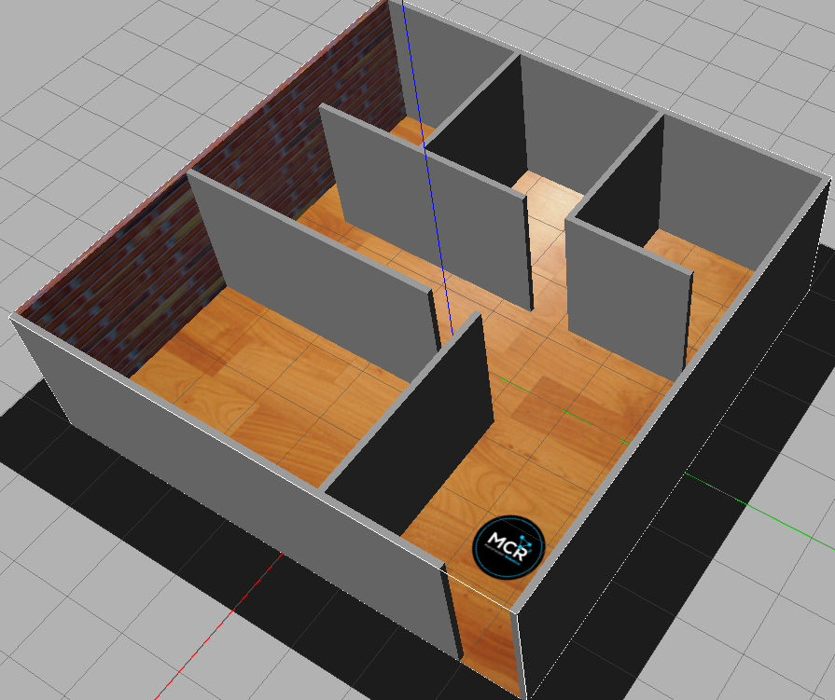
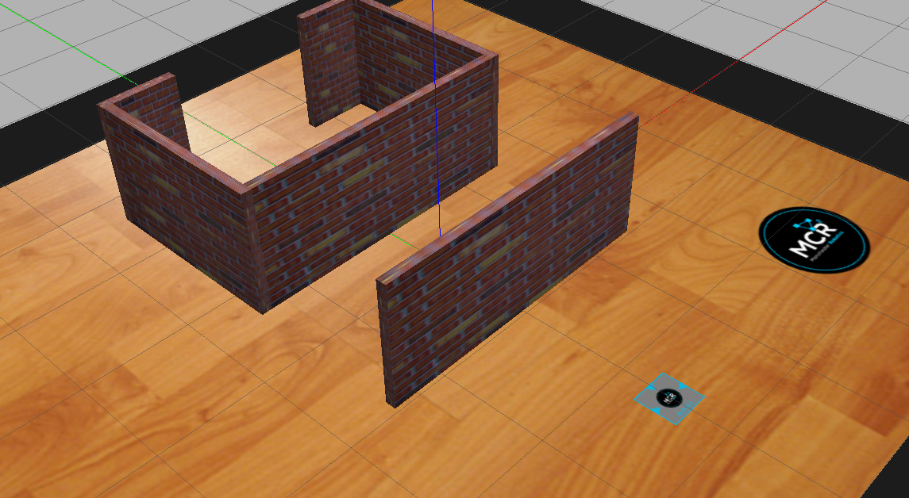
Changing the environment
Save the file
Follow the instructions in the previous section to initialise the Gazebo simulator.
The following models should appear on the screen.

